Slide 1
Chapter 3
Early African Societies

Slide 2
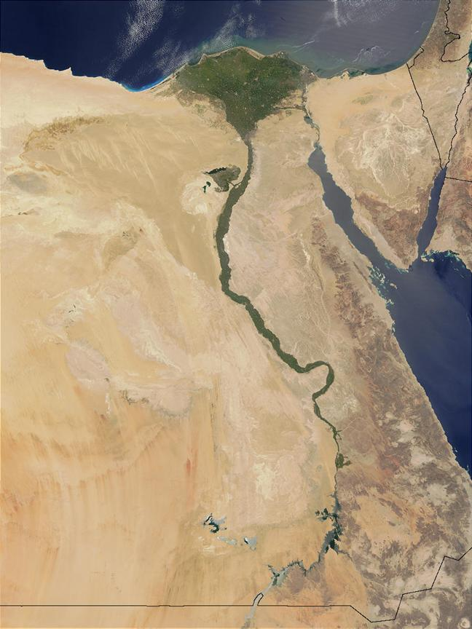
The Nile River
The Nile is the longest river in the world.
4,160 miles in length
The Nile runs South to North (One of only 2 rivers in the World!)
Prior to completion of the Aswan Dam in 1968 CE, The Nile’s accumulated waters annually flooded the plains downstream.
When the waters receded they left behind a lay of rich, fertile muck, and those deposits supported a remarkably productive agricultural economy throughout the Nile River valley.

Slide 3
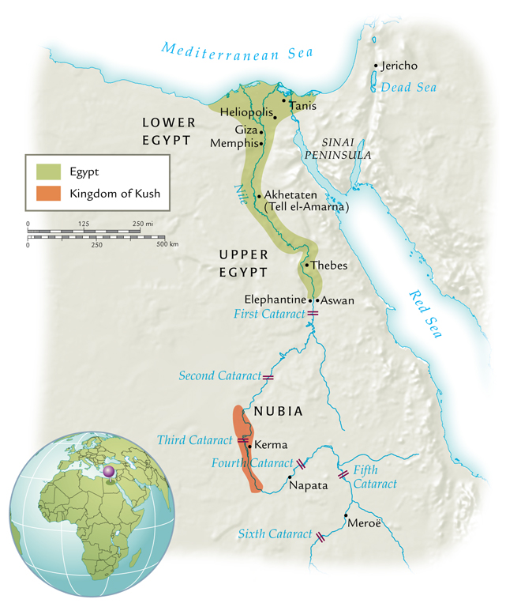
Advantages of the Nile
The South-North flow allows travel and transportation of goods.
Yearly floods create fertile soil
Deposits of granite, sandstone, and limestone
Warm weather allows different kinds of crops to grow.
Both Egyptians and Nubians relied heavily on agriculture by 5000 BCE.
Because of the ease of growing crops, the Greek historian Herodotus (Father of History) called Egypt “The Gift of the Nile”.

Slide 4
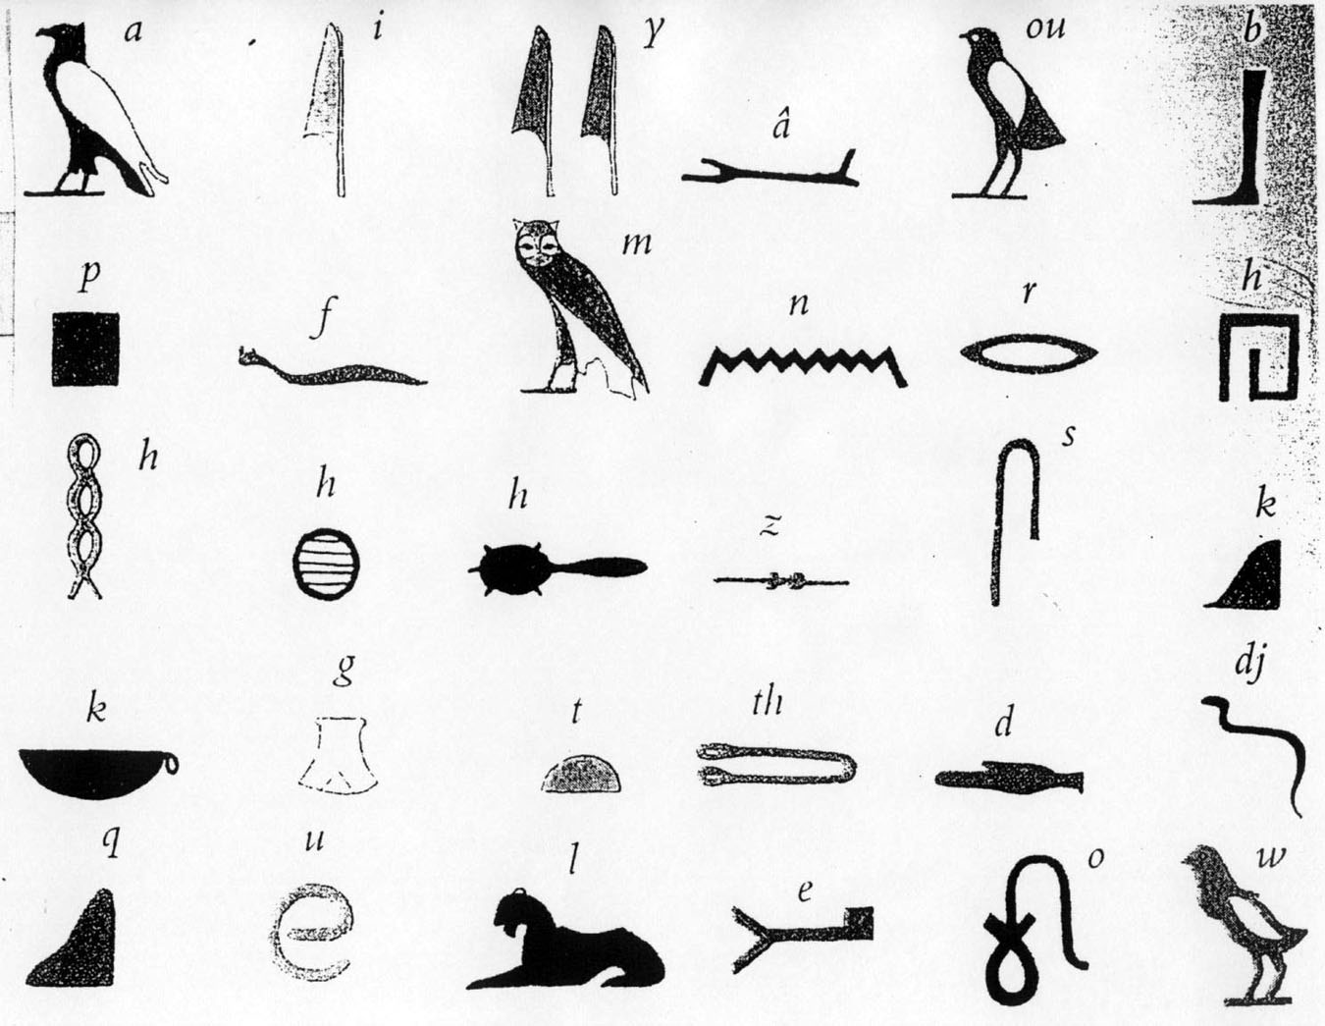
First Steps to Civilization
Pastoral nomads settle about 5000BCE
A form of writing called hieroglyphics develops around 3000 BC
Paper is made from papyrus
Egyptian hieroglyphics translated through the Rosetta Stone

Slide 5
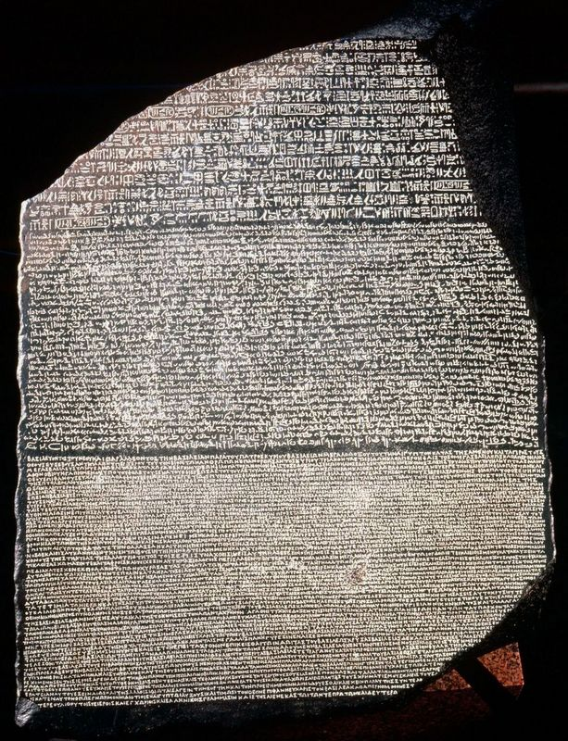

Slide 6
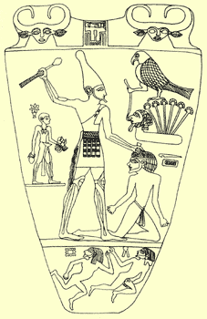
The Egyptian Kingdoms
Two distinct cultures develop, Upper and Lower Egypt
Menes is the first ruler to unite Egypt into one kingdom-3100 BC
Years later, the term Pharaoh is created to honor him and the rulers. It means “great house”
Unlike Mesopotamia, Egypt developed a strong central government

Slide 7
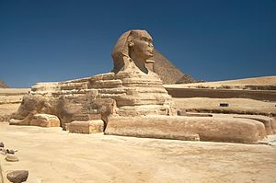
The Old Kingdom, 2680-2180 BC
Egyptian society is split into two social classes:
Lower = Peasants and farmers
Upper= Royal family, priest, scribes, and government officials
Great Pyramids and the Sphinx are constructed around 2500 BC.
The end of the Old Kingdom comes when the Pharaohs grow weak and the nobles strong, which leads to civil war.
Drought weakened Pharaohs’ claim to be a god
Memphis was the capital city

Slide 8
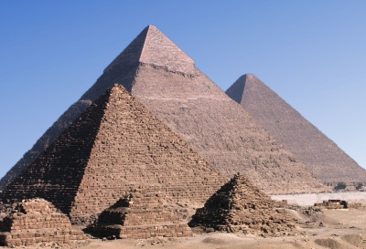

Slide 9
The Middle Kingdom, 2040-1780 BC
Mentuhotep II eventually took power; reuniting Upper and Lower Egypt, strengthened central government
Pharaohs wanted to be viewed as wise and caring
Huge irrigation projects were completed to turn more desert into farmland
Expanded borders
Invasion of the Hyksos ended the Middle Kingdom

Slide 10
Hyksos Invasions
A foreign people called the Hyksos invade
Not much is known about the Hyksos except that they reigned in the lower kingdom for around 100 years.
What little we do know about the Hyksos is that they used bronze weapons and used horses and chariots during warfare.
More wars and the driving out of the Hyksos lead to the New Kingdom

Slide 11
The New Kingdom, 1570-1080 BC
Pharaohs have absolute power and are treated as gods
Akhenaton tried to make Egypt monotheistic and worship Aten (1350). This disrupted the whole Egyptian society. Upon his death, the old religion was restored.
Rames the Great was the best pharaoh in Egyptian history. He took power in 1290 BCE
Expanded borders, more temples
Rames brought Egypt to it’s height, but attracted a lot of attention. After his death, his successors were unable to maintain his territory.
Hittites, Libyans, Assyrians, Persians, Macedonians, Rome

Slide 12
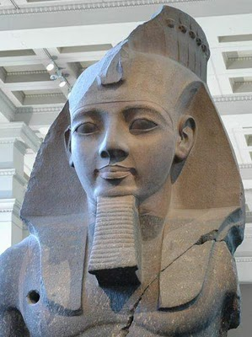
Decline of Egypt
Ramses II is the last of the powerful pharaohs
Egypt weakened by foreign invading forces.
Later after the Greeks and Romans invade, the Pharaohs will rule again, but in name only.

Slide 13
Egyptian Society
Royal families, nobles, priests ( all landowners)
Artisans
Farmers
Slaves
All classes except slaves were equal before the law
Egyptian women could own property, make contracts, divorce, and sue others
Polytheistic, mummification
Egyptian culture changed very little over the course of 3,000 years

Slide 14
Egyptian Contributions
Hieroglyphics
Papyrus
Book of the Dead
Pyramids (math and engineering)
Fractions and geometry
365 day calendar
Mummification helped doctors learn about the human body- set broken bones, stitches, amputations

Slide 15
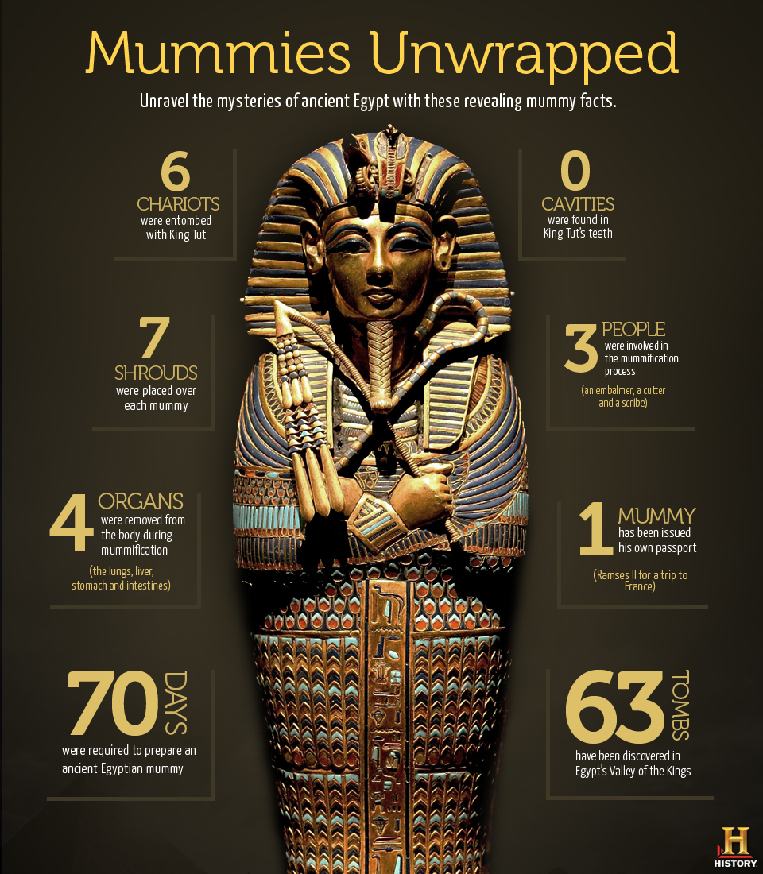

Slide 16
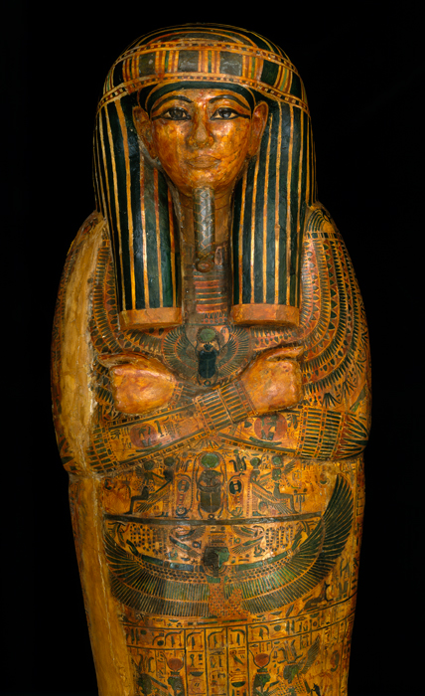
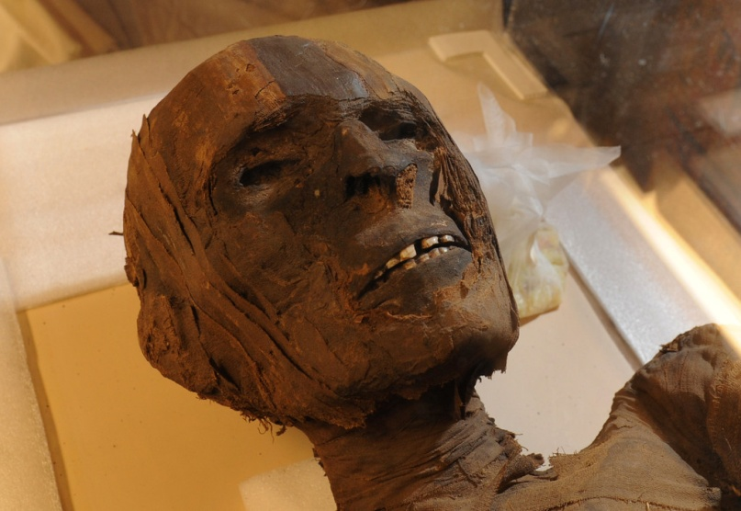
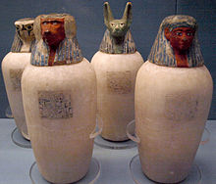

Slide 17
Nubia, Axum and Kush
Developed south of Egypt, traded across the Red Sea
Nubia copied a lot of Egyptian ways, mostly farmers
Kush would replace Nubia (1000 BCE-663 BCE)
Traded with Roman empire, India, and Arabia
Axum came to power in modern day Ethiopia (100 CE)
Successful trading colony
Interaction with Romans allowed many Axumites to convert to Christianity. This allowed for Ethiopia to remain Christian for many centuries; even after Islam converted most of Africa

Slide 18
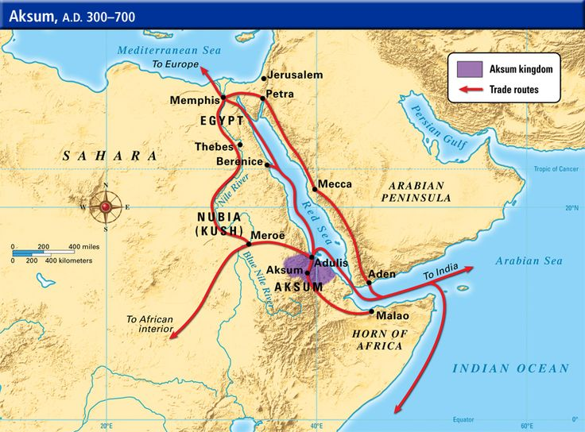

Slide 19
Chapter 4
Early Societies in South Asia

Slide 20
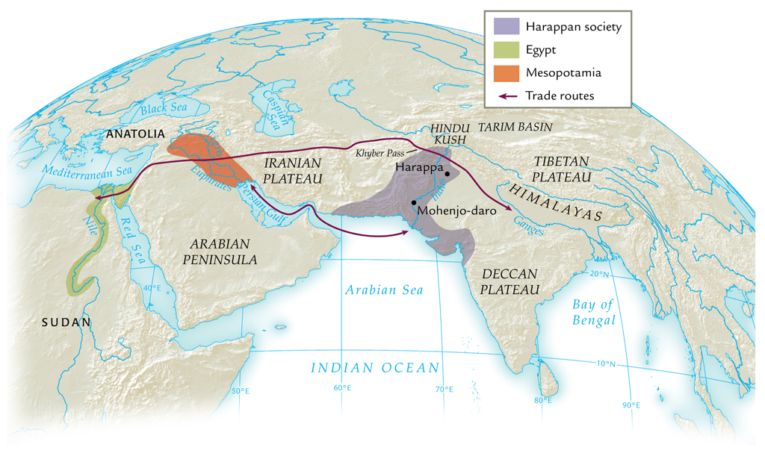
Harappan Society and Its Neighbors, ca. 2000 B.C.E.

Slide 21
Foundations of Harappan Society
The Indus River
Silt-enriched water from mountain ranges
Major society built by Dravidian peoples, 3000-2500 B.C.E.
Cultivation of cotton before 5000 B.C.E., early cultivation of poultry
Decline after 1900 B.C.E.
Major cities: Harappa (Punjab region) and Mohenjo-daro (mouth of Indus River)
70 smaller sites excavated (total 1500)

Slide 22
Mohenjo-Daro Ruins
Population about 40,000
Regional center
Layout, architecture suggests public purpose
Broad streets, citadel, pool, sewage
Standardized weights evident throughout region
Specialized labor
Trade

Slide 23
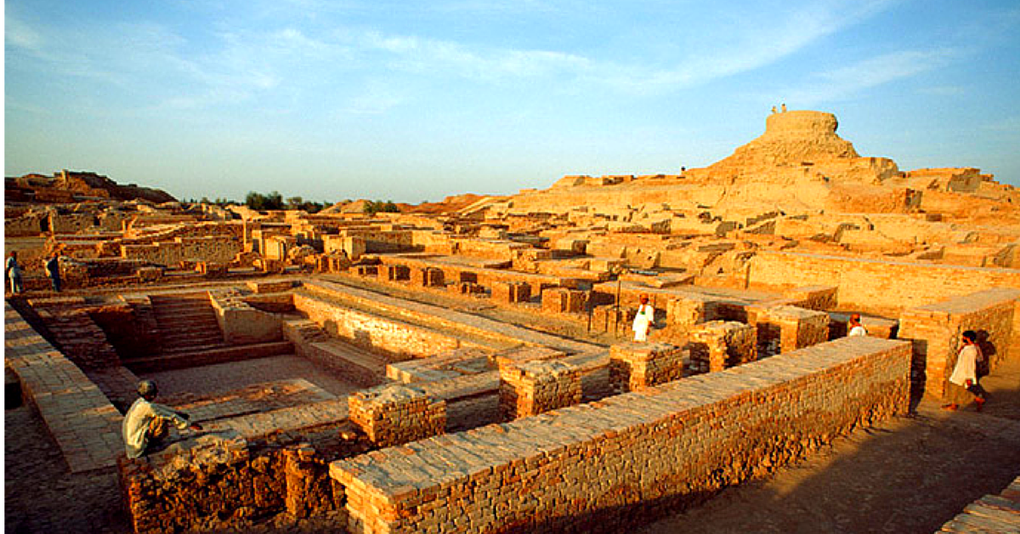

Slide 25
Harappan Society and Culture
Evidence of social stratification
Dwelling size, decoration
Harappan civilization: influence on later Indian culture
Statues, figurines, and illustrations reflect a tradition of art and metallurgy
Venerated goddesses of fertility

Slide 26
Mysterious End of Harappan Civilization
Reasons for disappearance unclear
Excessive deforestation, loss of topsoil
Earthquakes?
Flooding?
Evidence of unburied dead
Disappearance by 1500 B.C.E.

Slide 27
The Early Aryans
Indo European pastoral nomads used horses to take over northern India in 1500 BCE
Aryan tribe was divided into clans which means no central government
Pastoral economy: sheep, goats, horses, cattle
Cattle not sacred until many centuries later
Sanskrit: sacred tongue
Prakrit: everyday language, evolved into Hindi, Urdu, Bengali
1200 BCE a writing system was developed

Slide 28
The Vedic Age
Conflicts between Aryans and indigenous dasas (“enemies,” “subjects”)
Aryans fighting Dravidians
Also Aryans fighting each other
Chiefdoms: rajas
Early concentration in Punjab, migrations further south
Development of iron metallurgy
Increasing reliance on agriculture
Tribal connections evolve into political structures

Slide 29
Patriarchy in Ancient Indian Society
“Rule of the father”
A social order that stood alongside the caste system, and varna hierarchy
Enforced in the Lawbook of Manu
Women to be subject to fathers, husbands, sons
Women’s most important duties to bear children and maintain wholesome homes

Slide 30
Aryan Religion
The Vedas; Sanskrit for knowledge
Collection of hymns, poems and songs
The Rig-Veda, sheds light on Aryan society
Major deity of Rig Veda: Indra, war god
Elaborate ritual sacrifices to gods
Role of brahmins important
Ca. 800 B.C.E. some movement away from sacrificial cults
Mystical thought, influenced by Dravidians

Slide 31
Varna: The Caste System
Origins in Aryan domination of Dravidians
Brahmin, priest
Kshatriya, warrior
Vaishya, merchant
Shudra, serf
“Untouchables”
Jati system of subcastes
Related to urbanization, increasing social and economic complexity

Slide 32
Teachings of the Upanishads
Texts that represent blending of Aryan and Dravidian traditions
Composed 800-400 B.C.E., some later collections until thirteenth century C.E.
Brahman: the universal soul
Samsara: reincarnation
Karma: accounting for incarnations
Moksha: mystical ecstasy
Relationship to system of Varna
Would be the basis of Hinduism

